Slide 1
Basics of ML and DL using Python
-Adithya Thonse

Slide 2
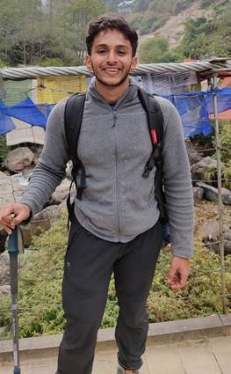
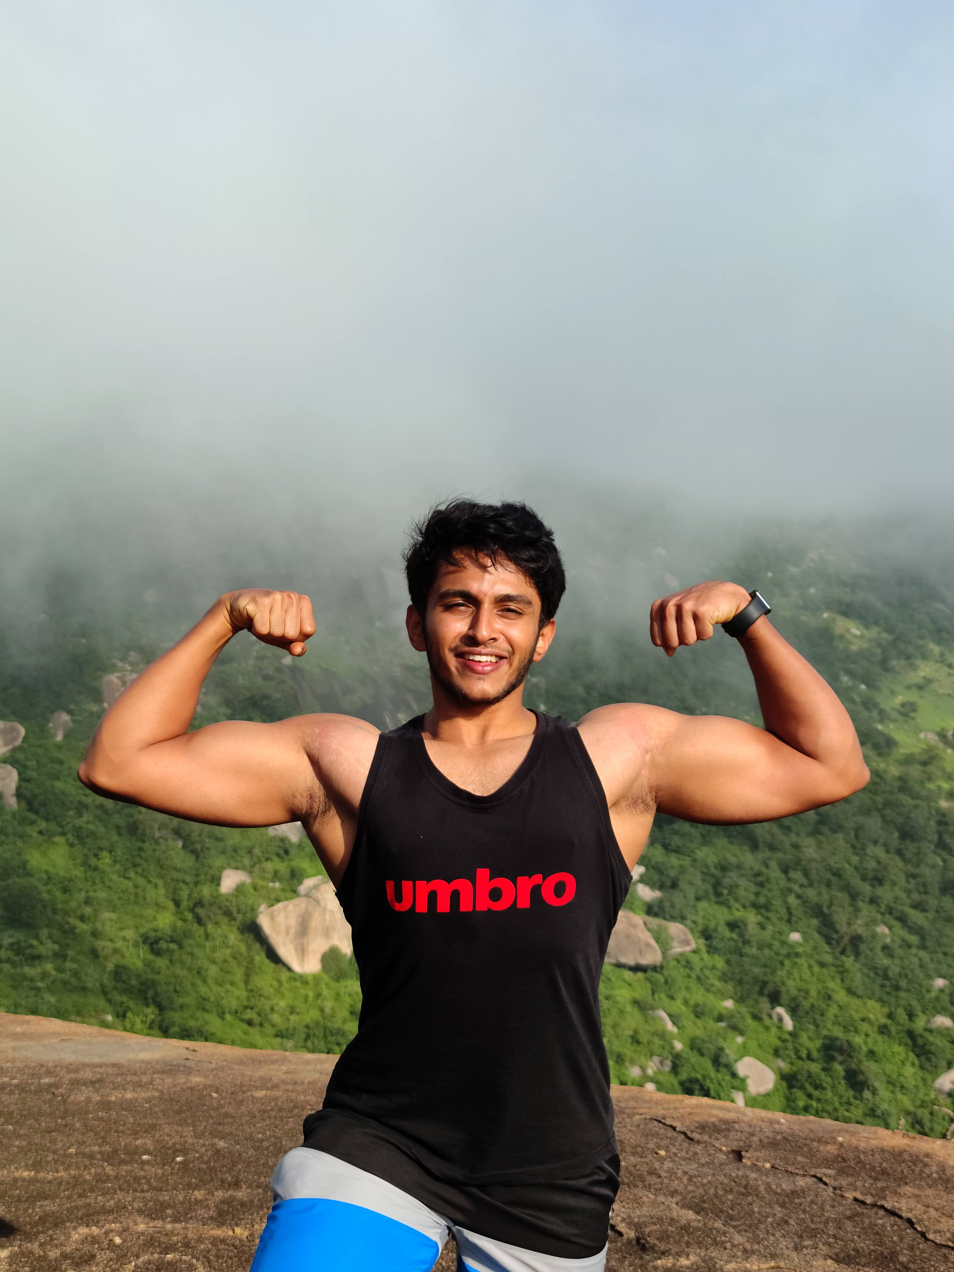
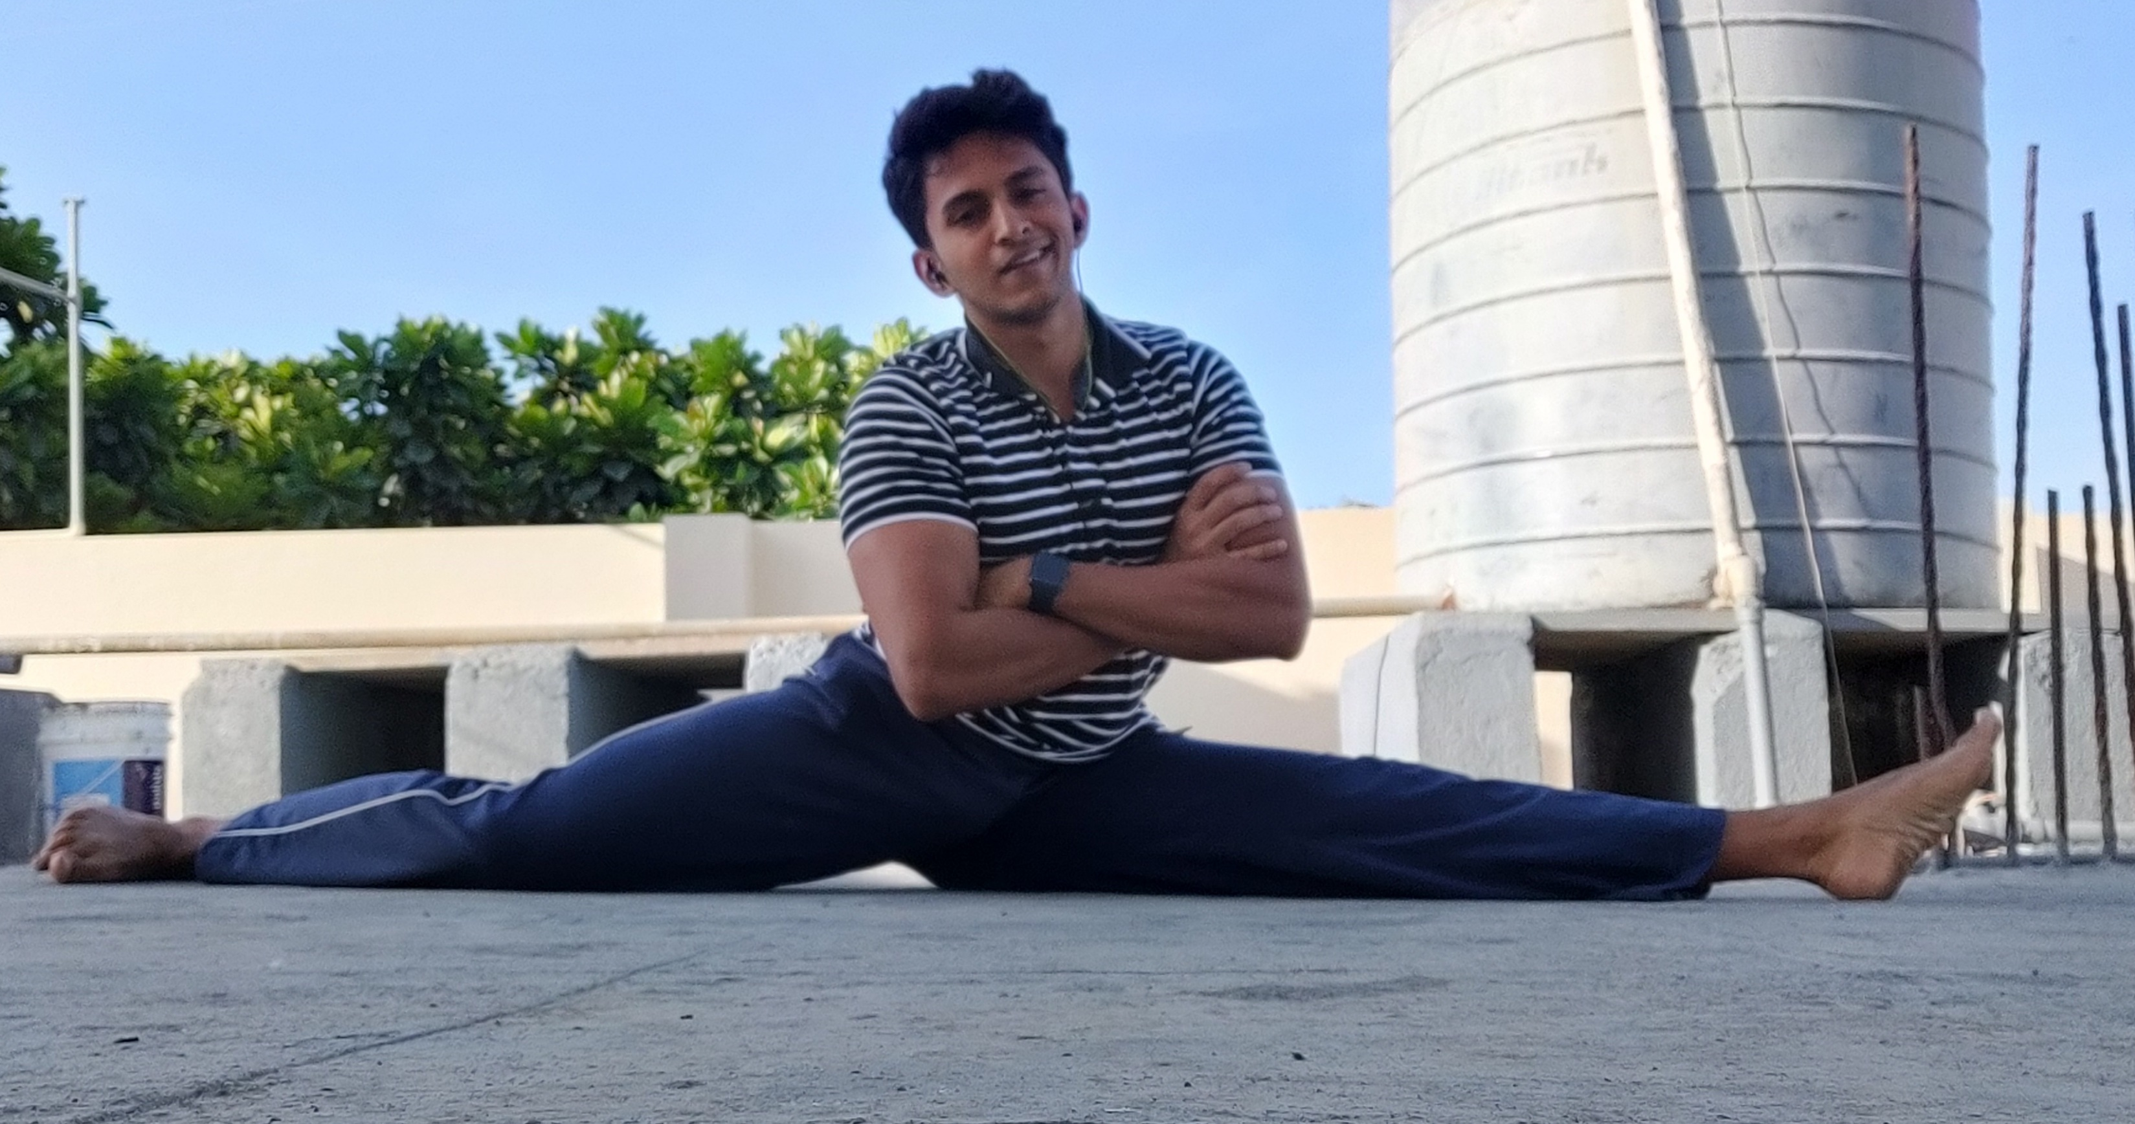
About Me
Electronics Engineer with background in Deep Learning for Embedded Applications
Expertise in TinyML
Vision Applications
Predictive Maintenance
Real Time Anomaly Detection
4 years experience at Texas Instruments
Trekking Enthusiast, Gym Freak, Cyclist

Slide 3
Generic Info about this course
Entirely taught using jupyter notebooks. Using Google Colab
Pre-requisite: Basic understanding of programming.
Course material available at GitHub
Includes course teachings - Course Teaching- Python and ML
And self practice notebooks - Python_Basics_Practice
Concepts will be taught via a single consolidated presentation
You can mail me anytime at: adithya.t@intellipredikt.com

Slide 4
Class 1 Takeaways

